Slide 1
A Spherical Cow Approximation to Symmetric Li Ion Cells
Javier Bareño

Slide 2
Spherical Cow Approximation
Cell behavior is approximated by the V-Q characteristic of each electrode, interpolated from experimental results in half cells
Different mechanisms shift and/or alter the Li inventory and electrode loading
Cell V is calculated as the V difference between electrodes
Kinetic effects are not considered, other than (possibly) introducing an ad-hoc overpotential to approximate internal resistance and polarization
Keenan Crane
http://www.cs.cmu.edu/~kmcrane/Projects/ModelRepository/

Slide 3
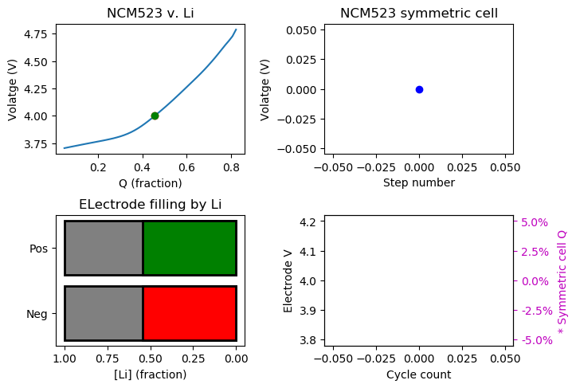
Ideal Symmetric Cell
We start from a cell consisting of two NCM523 electrodes, each charged to 4.0 V v. Li/Li⁺
Each NCM523 electrode is approx. 54% full of Li
Cell voltage is 4.0 V – 4.0 V = 0 V

Slide 4
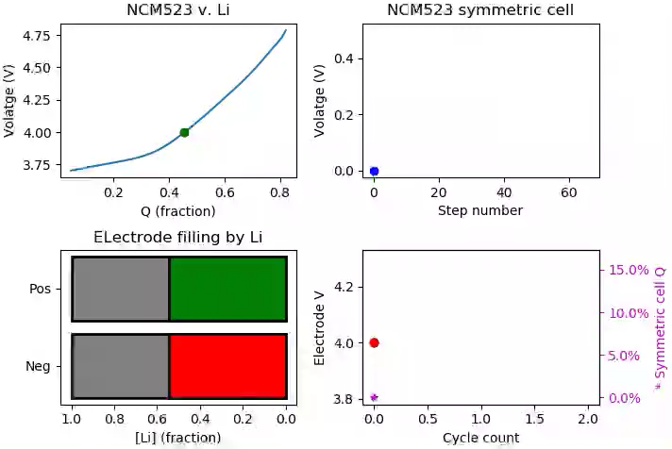
Ideal Symmetric Cell: 1st Charge
As the cell charges to 0.5 V, Li moves from cathode to anode
Cell is balanced, each electrode changes SOC by same amount
No internal red/ox currents: measured cell capacity matches electrode EOS change

Slide 5
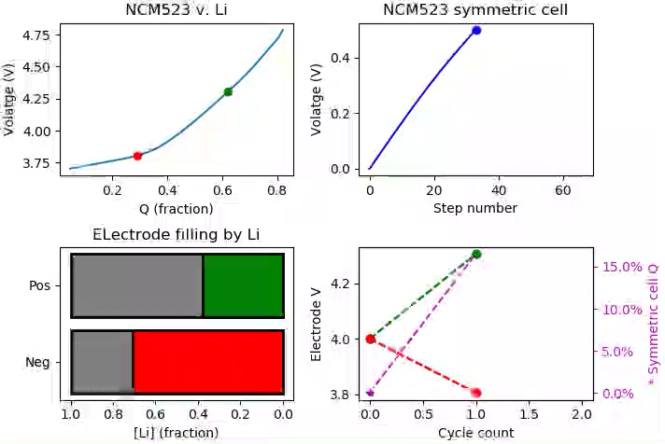
Ideal Symmetric Cell: 1st Discharge
Upon cell discharge to 0 V, Li goes back to the cathode
No Li inventory change or shift:
Discharge capacity matches charge capacity
Both electrodes go back to initial 4.0 V v. Li

Slide 6
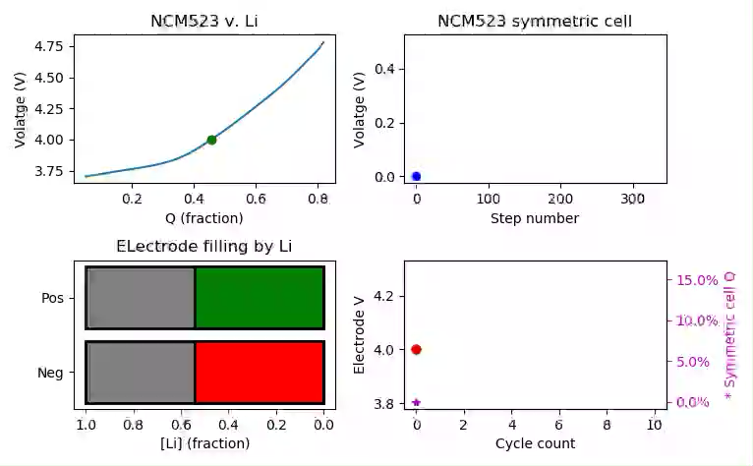
Ideal Symmetric Cell: Cycling
Upon cycling:
Charge keeps constant
No V drift

Slide 7
Active Material Loss
A process that effectively reduces the loading of one or both electrodes
E.g. , particle disconnection from current collector
May result in loss of Li inventory, depending on SOC of lost material
Does not change the effective SOC of the remaining material and does not require a compensating current

Slide 8

AML: Cathode Loss at Top of Charge First Charge
Initial charge to 0.5 V similar to ideal cell case

Slide 9
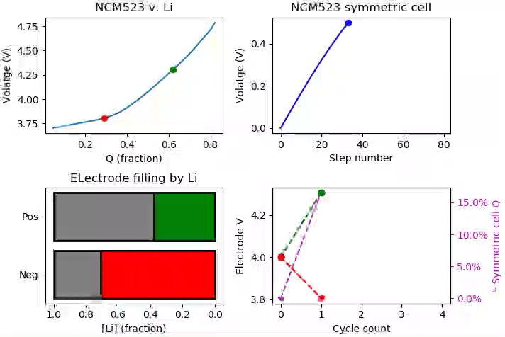
AML: Cathode Loss at Top of Charge Loss of AM at cathode
At top of charge, 65% of cathode active material is lost; e.g., particle disconnection during a hold
The loss does not change the SOC of any electrode, but reduces the capacity (Li intercalation sites) of the cathode

Slide 10
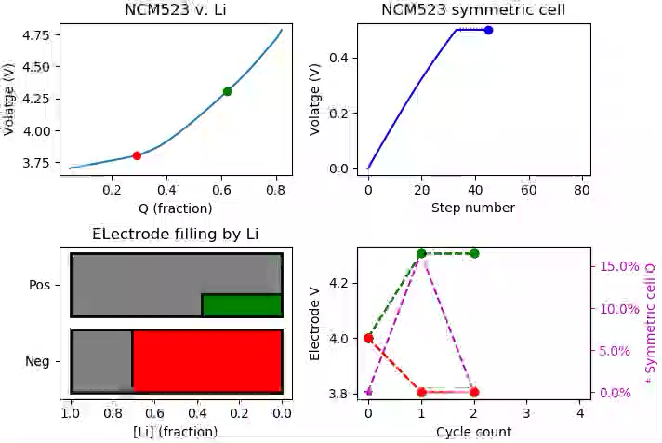
AML: Cathode Loss at Top of Charge First Discharge
During discharge, Li travels back from anode to cathode
It takes (65%) less Li to discharge the cathode back to 4.0 V v Li than it took to charge it before AM loss
There is still Li at the anode

Slide 11

AML: Cathode Loss at Top of Charge First Discharge
The cell continues to discharge, and V_{C} continues to drop, until both electrodes reach same potential (lower than discharged state before cathode loss)
Less Li comes back from the anode than what was charged: Q_disch < Q_ch

Slide 12
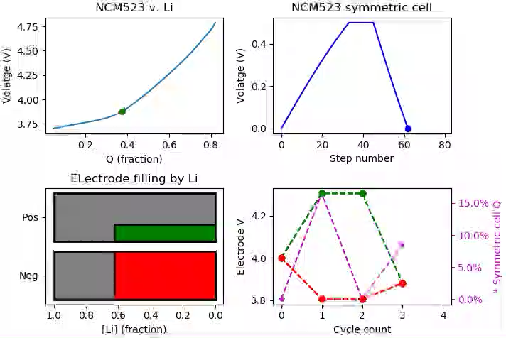
AML: Cathode Loss at Top of Charge Second Charge
In the discharged cell, both electrodes sit at lower potential v. Li
During the second charge, it takes the same amount of Li as in first discharge to return each electrode to the same charged SOC

Slide 13
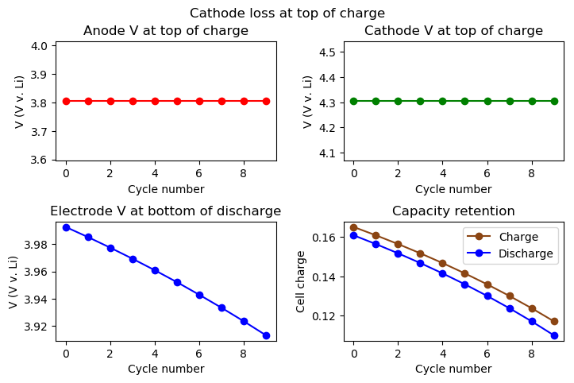
AML: Cathode Loss at Top of Charge Extended cycling
5% cathode AM loss at top of each charge
Electrode voltages at top of charge remain constant
Electrode voltages at bottom of discharge keep falling
Cell capacity drops
Q_{D} = Q_{C}^{previous}

Slide 14
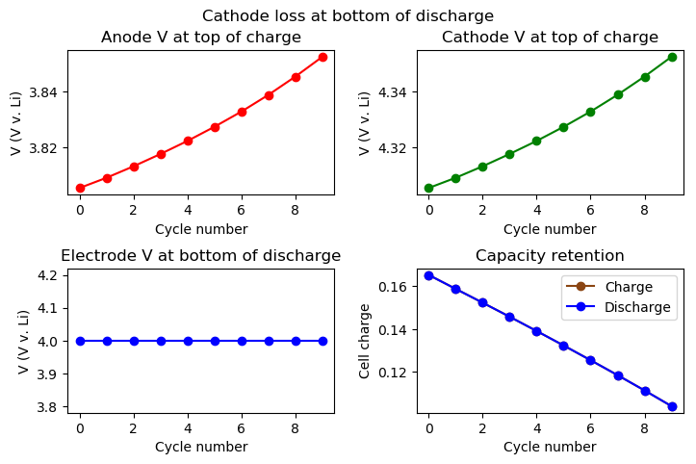
AML: Cathode Loss at Bottom of Discharge Extended cycling
5% cathode AM loss at bottom of each discharge
Does not change electrode voltages, which remain constant at bottom of discharge
Li loss from lithiated cathode loss:
100% CE
Cell capacity drops
Electrode V at top of charge increases

Slide 15
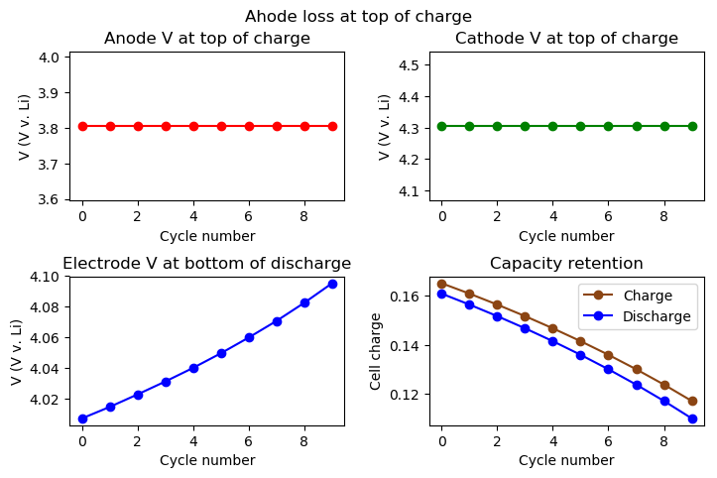
AML: Anode Loss at Top of Charge Extended cycling
5% anode AM loss at top of each charge
Does not change electrode SOC, V^{A/C} in charged cell constant
Li loss from lithiated anode drives electrode V increase in discharged cell

Slide 16
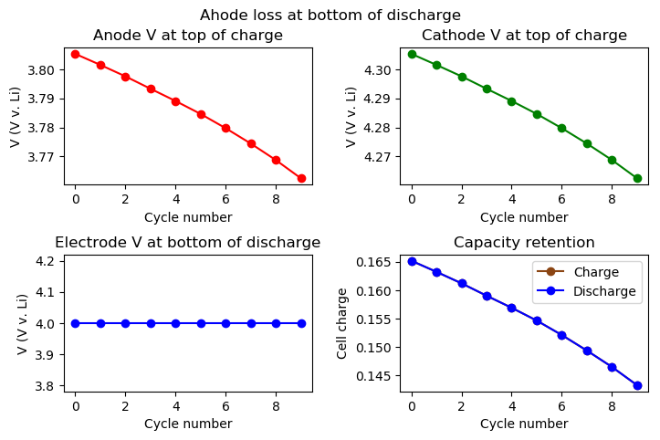
AML: Anode Loss at Bottom of Discharge Extended cycling
5% anode AM loss at bottom of each discharge
Does not change electrode SOC, V^{A/C} in discharged cell constant
V^{A/C} drops in charged cell because anode cannot accept all Li from cathode upon charge

Slide 17
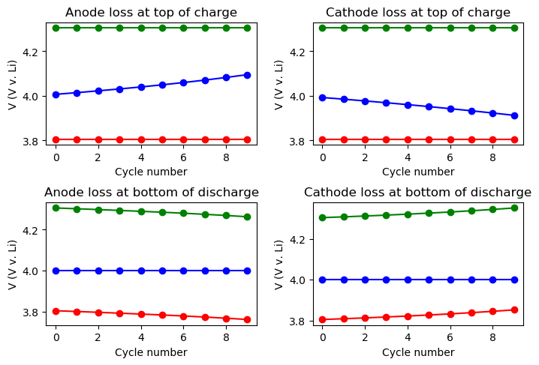
AML: Extended Cycling Comparison
Voltage creep occurs at opposite end of charge-discharge cycle to active material loss
Direction of voltage creep switches with anode or cathode loss and with end of C-D cycle at which AML occurs

Slide 18
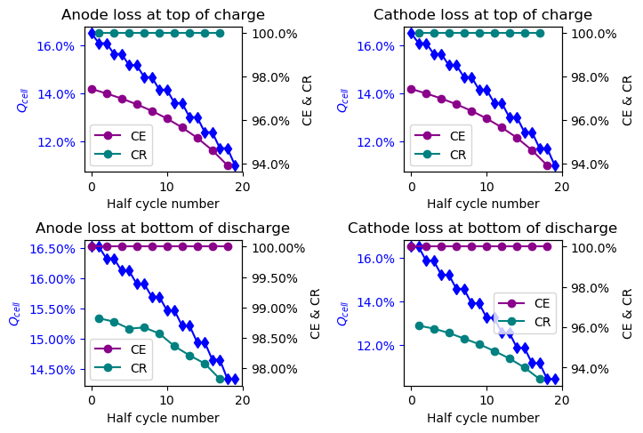
AML: Extended Cycling Comparison
First half cycle is charge
CE = Q^{D}/Q^{c}_{previous}
CR = Q^{C}/Q^{d}_{previous}
AML leads to Q_{cell} loss in all cases
AML at top of charge: coulombic inefficiency
AML at bottom of discharge: capacity loss between cycles

Slide 19
Next Steps
Explore the effect of redox currents:
Li inventory change and/or shift
Mismatch between measured Q_{cell} and electrode SOC changes
No associated AML
Explore the effect of Li reorganization
Redox effects without compensating current
Causes AML
Compare to experimental data (KK48RT3)

Slide 20

Li reorganization / phase transitions
After initial charge to 0.5 V, 25% of cathode is lost but its Li is transferred to the remaining cathode
This causes cathode self discharge, with no Qcell nor changing anode SOC

Slide 21

Li reorganization / phase transitions
During a voltage hold, external Qcell needs to be supplied to recharge the cell after the cathode self discharge
Can be approximated by a series of charge-phase transition cycles

